Slide 1



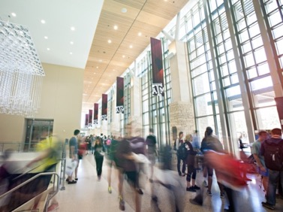
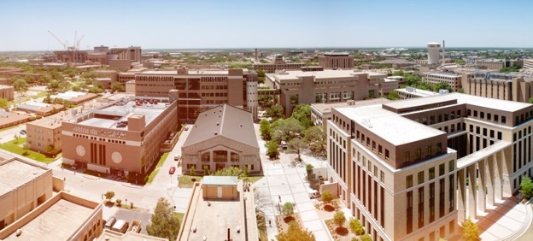
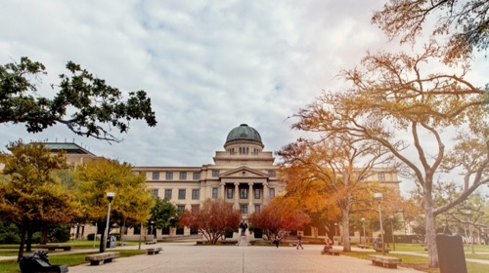
TIME SERIES Forecasting OF STOCK MARKET
SJIET
ELAVUR
PRESENTED BY:
ELAVARASAN.S
v

Slide 2
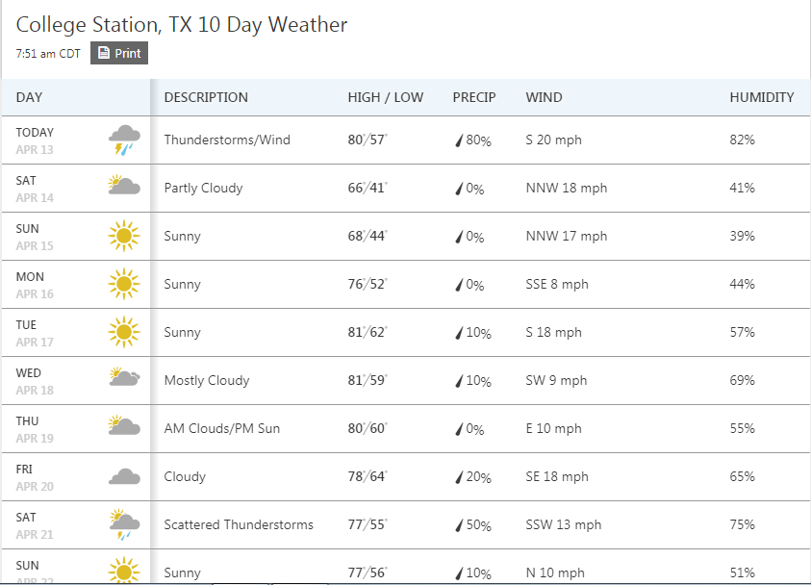
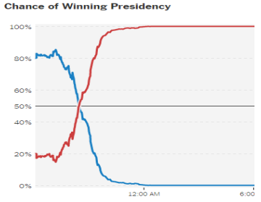
forecasting
SJIET
ELAVUR
Forecasting is the process of making predictions of the future based on past and present data!

Slide 3
forecasting
SJIET
ELAVUR
Coming up with predictions is important.
It is also very hard since none has the correct model of the world.
Explaining a particular kind of prediction is equally important, since you can make a more compelling case out of it.

Slide 4
How to forecast?
SJIET
ELAVUR
Are causal relationships necessary for forecasting?
Not necessarily!
A lot of times, the past observations of certain variables are the best forecasters of future observations.
Can we just use anything?
Not necessarily, since there are a lot of spurious co-movements.
What to do?
Strike a balance!
Good models are the ones that capture time series properties of the data, as well as adhere to some economic theory.

Slide 5
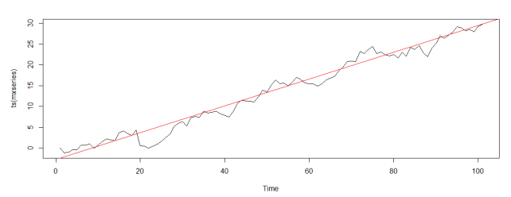
Some Key Concepts
SJIET
ELAVUR
Trend
Trend is component of time series that represents variations of ow frequency (usually with period longer than 8 years).
Source: www.oraylis.de/blog/trend-in-times-series-analysis

Slide 6
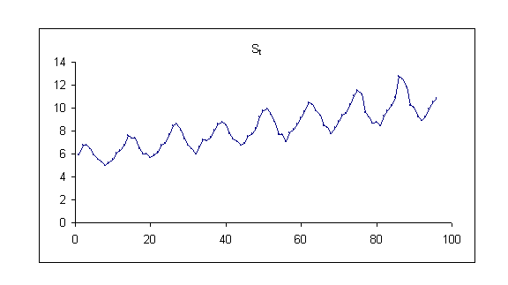
Some Key Concepts
SJIET
ELAVUR
Seasonality
Seasonality is component of time series that represents intra year fluctuations. More or less stable year after year.
Source: www.epixanalytics.com/modelassist/AtRisk/Model_Assist.htm#Time_series/Seasonal_time_series.htm

Slide 7
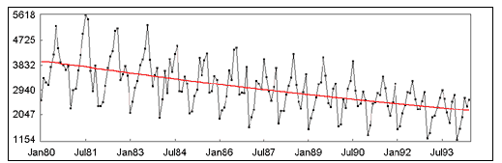
Some Key Concepts
SJIET
ELAVUR
Trend + Seasonality
Source: http://www.gistatgroup.com/cat/examples/ex_1_4.html

Slide 8
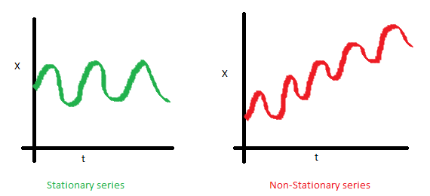
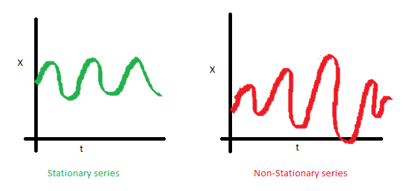
Some Key Concepts
SJIET
ELAVUR
Stationary Series
Constant Mean
Constant Variance
Why do we care about ‘Stationarity’ in Time Series Forecasting?

Slide 9
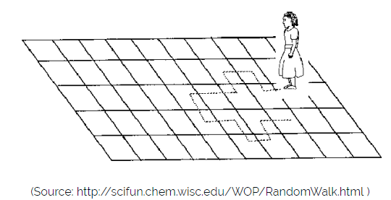
Some Key Concepts
SJIET
ELAVUR
Random Walk
X(t) = X(t-1) + Er(t)

Slide 10
Data
SJIET
ELAVUR
The Standard & Poor's 500, often abbreviated as the S&P 500, or just the S&P, is an American stock market index based on the market capitalizations of 500 large companies having common stock listed on the NYSE or NASDAQ.
S&P 500 is a good representative of US stock market as well as US economy.
Stock Prices from January, 1995 to March 2018 are used for forecasting.

Slide 11
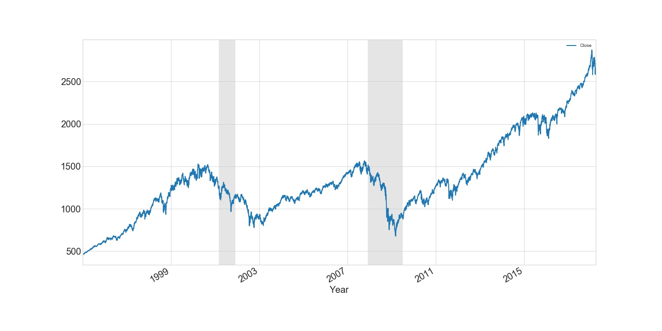
Exploratory Data Analysis
SJIET
ELAVUR

Slide 12
Some Key Concepts
SJIET
ELAVUR
Random Walk
X(t) = X(t-1) + Er(t)

Slide 13
Exploratory Data Analysis
SJIET
ELAVUR
S&P 500 Daily Stock Prices

Slide 14
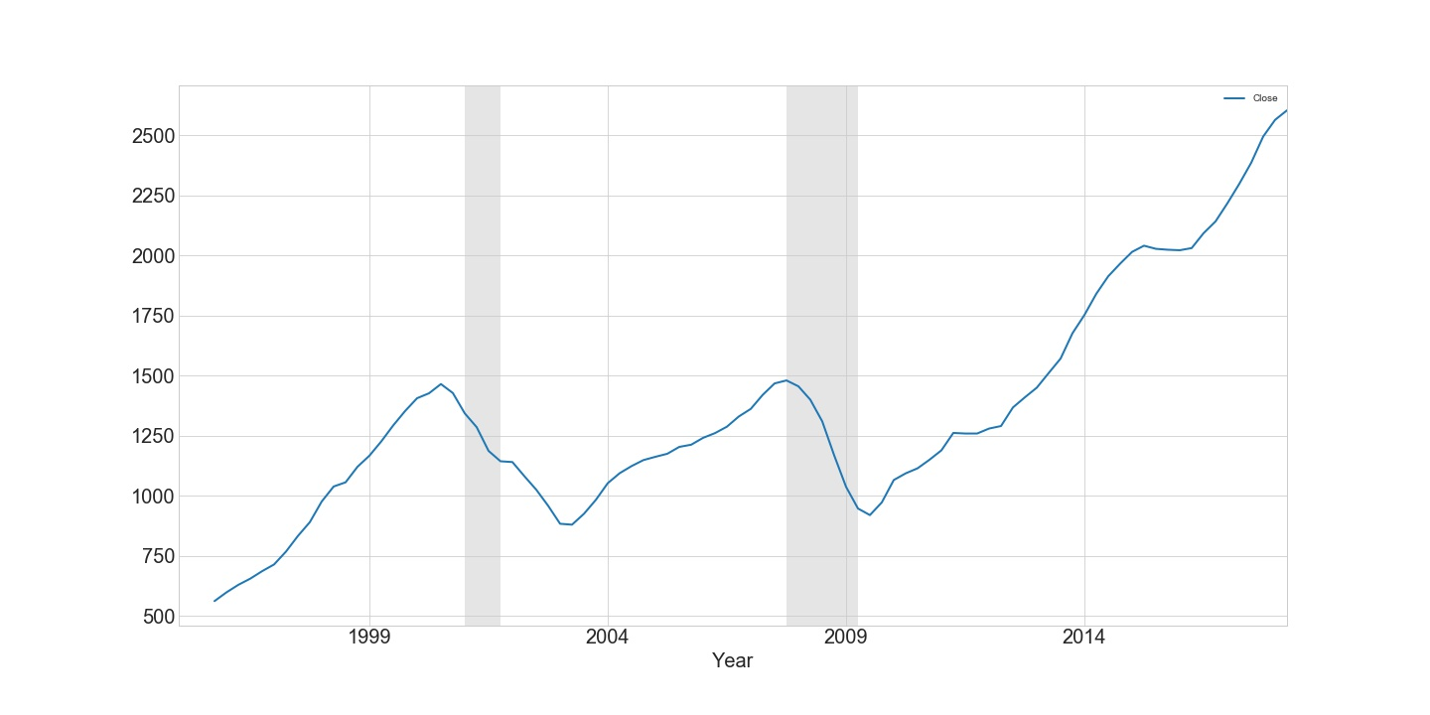
Exploratory Data Analysis
SJIET
ELAVUR
Trend

Slide 15
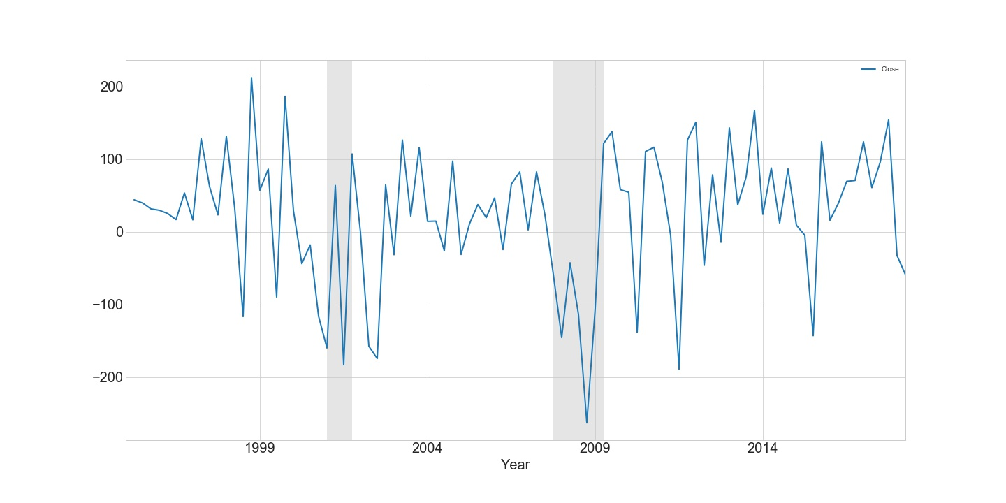
Exploratory Data Analysis
SJIET
ELAVUR
Stationarity

Slide 16
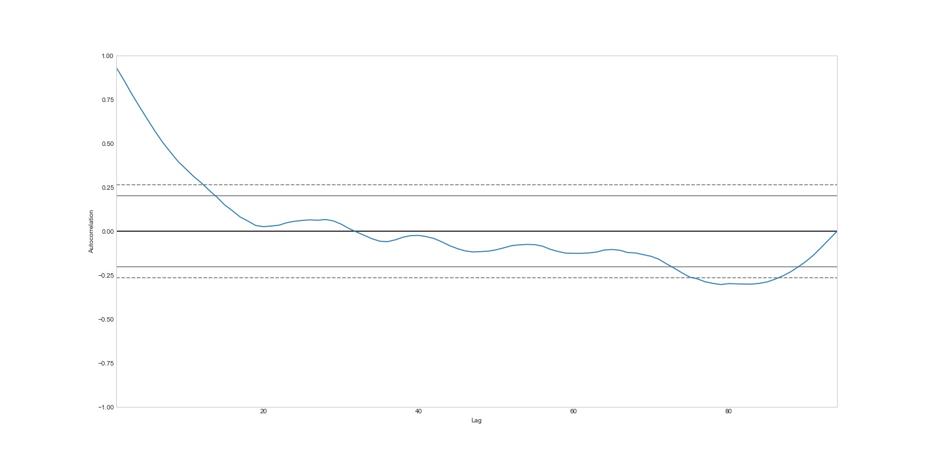
Exploratory Data Analysis
SJIET
ELAVUR
Auto-Correlation

Slide 17
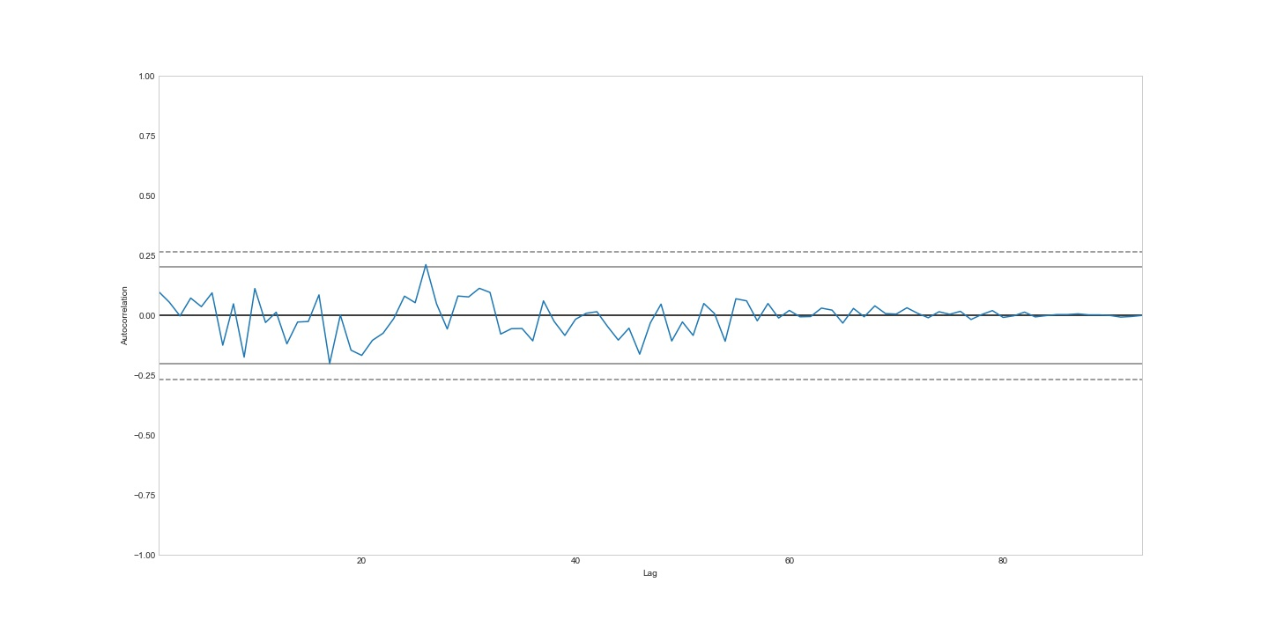
Exploratory Data Analysis
SJIET
ELAVUR
Auto-Correlation

Slide 18
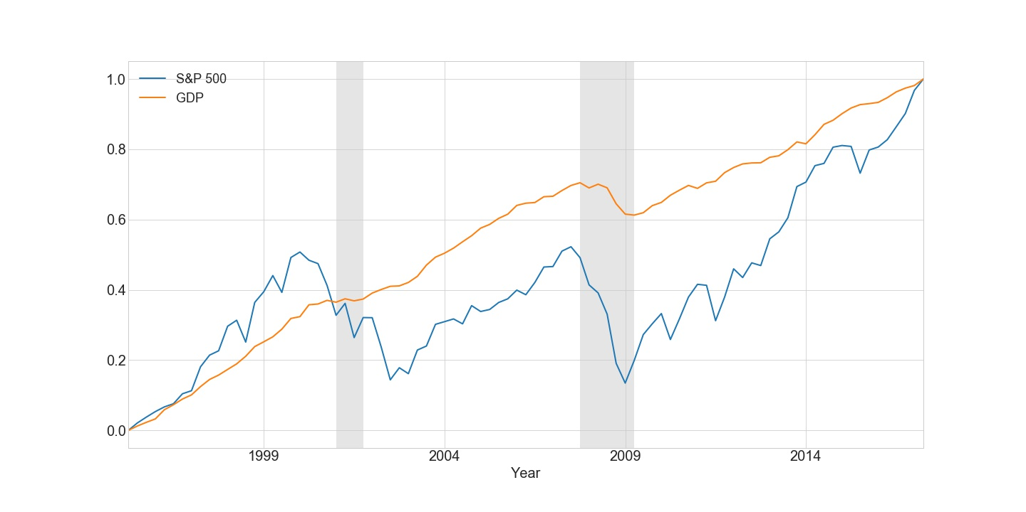
Exploratory Data Analysis
SJIET
ELAVUR
S&P 500 vs GDP

Slide 19
Modeling
SJIET
ELAVUR
ARIMA
Stands for Autoregressive Integrated Moving Average
AR (Autoregressive model):
The autoregressive model specifies that the output variable depends linearly on its own previous values
AR(p) Y_{t} = β₀ + β₁Y_{t-1} + β₂Y_{t-2} + ... + β_{p}Y_{t-p} + e_{t}

Slide 20
Modeling
SJIET
ELAVUR
MA (Moving Average):
Moving average model is a common approach for modeling univariate time series. It specifies that the output variable depends linearly on the current and various past values.
MA (q) Y_{t} = µ + e_{t} + θ₁e_{t-1} + θ₂e_{t-2} + ... + θ_{q} e_{t-q}
* ARIMA models are generally denoted ARIMA(p,d,q) where parameters p, d, and q are non-negative integers, p is the order (number of time lags) of the autoregressive model, d is the degree of differencing (the number of times the data have had past values subtracted), and q is the order of the moving average model.

Slide 21
Modeling
SJIET
ELAVUR
RNN– Recurrent Neural Networks
What is RNN ?
Why are we using RNN for time series ?
Why not regular Neural Nets?

Slide 22
Modeling
SJIET
ELAVUR
Context
Simple multi-layered neural networks classifiers – When given a certain input, tag the input as belonging to one of the many classes.
https://www.pyimagesearch.com/2016/09/26/a-simple-neural-network-with-python-and-keras/

Slide 23
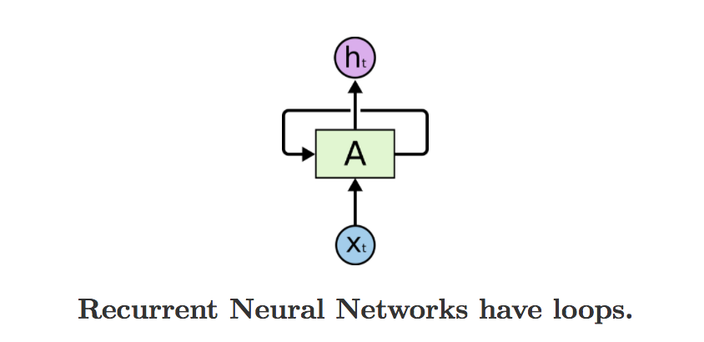
Modeling
SJIET
ELAVUR
RNN
As the RNN traverses the input sequence, output for every input also becomes a part of the input for the next item of the sequence.
https://iamtrask.github.io/2015/11/15/anyone-can-code-lstm/

Slide 24
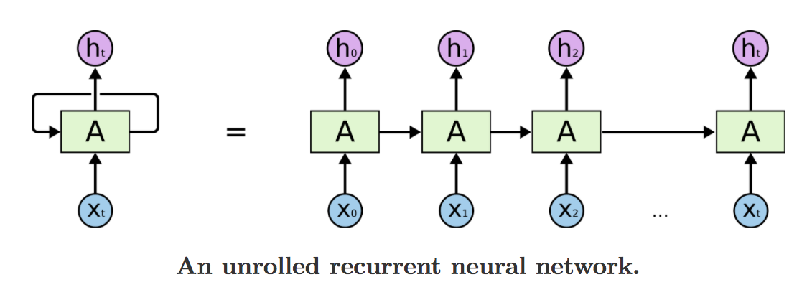
Modeling
SJIET
ELAVUR
RNN
https://iamtrask.github.io/2015/11/15/anyone-can-code-lstm/

Slide 25

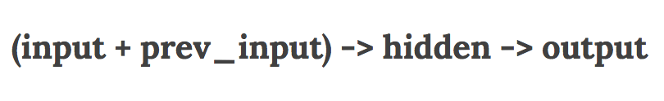
Modeling
SJIET
ELAVUR
RNN
There can be 2 types:

Slide 26
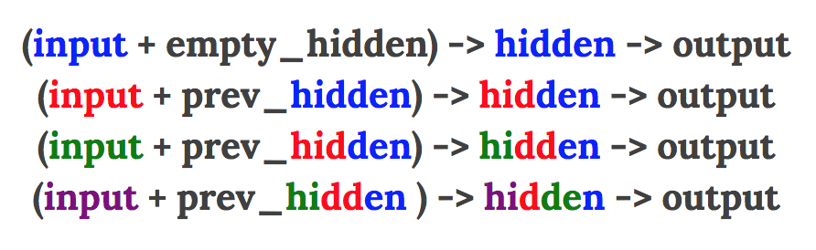
Modeling
SJIET
ELAVUR
RNN:-
Lets see which one works better or which one has better memory:
1) Hidden Layer Re-occurance
https://iamtrask.github.io/2015/11/15/anyone-can-code-lstm/

Slide 27
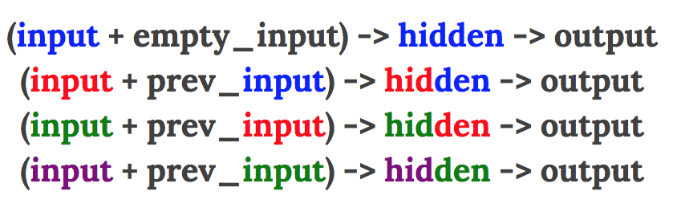
Modeling
SJIET
ELAVUR
RNN
2) Input layer re-occurance
https://iamtrask.github.io/2015/11/15/anyone-can-code-lstm/

Slide 28
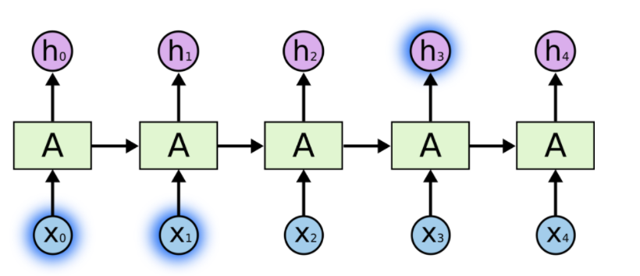
Modeling
SJIET
ELAVUR
Memory of RNN:

Slide 29
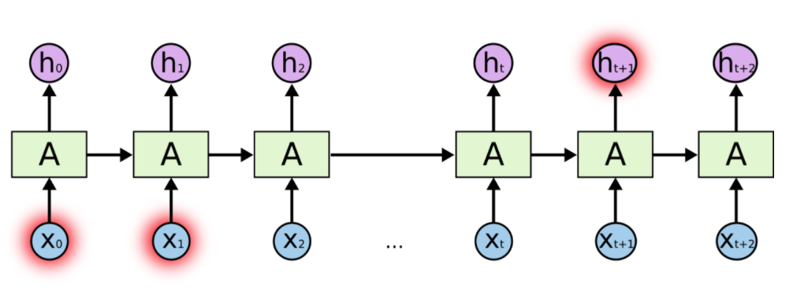
Modeling
SJIET
ELAVUR
Memory of RNN:

Slide 30
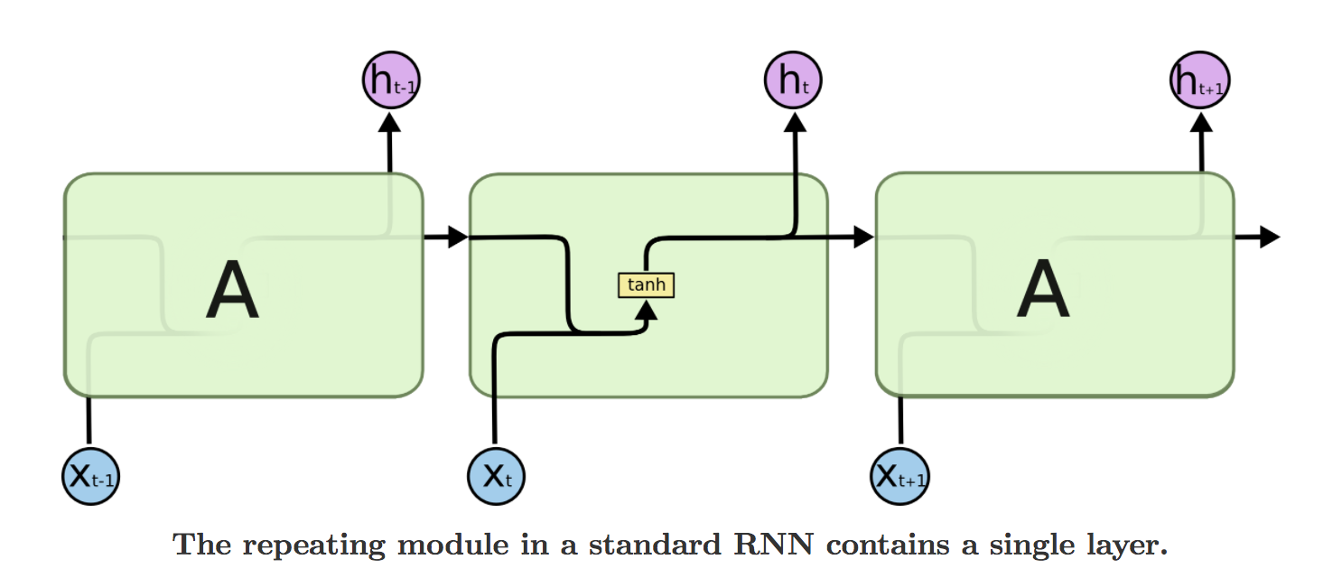
Modeling
SJIET
ELAVUR
Hidden layer of RNN:

Slide 31
Modeling
SJIET
ELAVUR
RNN with LSTM:
Long Short Term Memory is a RNN architecture which addresses the problem of training over long sequences and retaining memory.
A simple recurrent network suffers from a fundamental problem of not being able to capture long-term dependencies in a sequence.

Slide 32
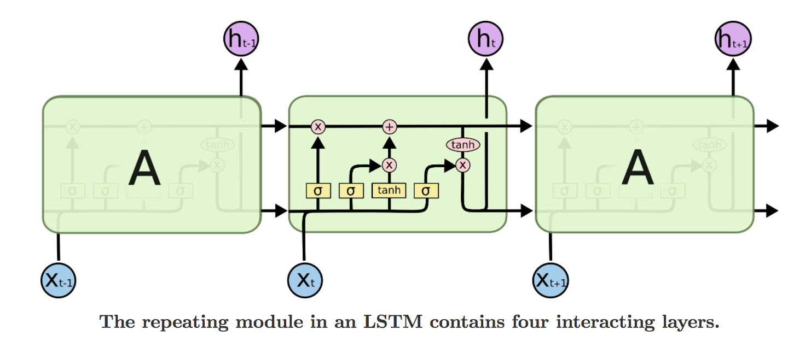
Modeling
SJIET
ELAVUR
Hidden layer of RNN with LSTM cell:
LSTM = Long short term memory

Slide 33
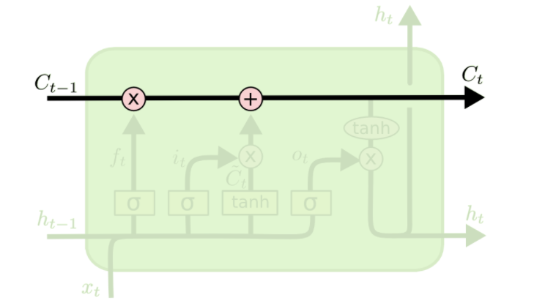
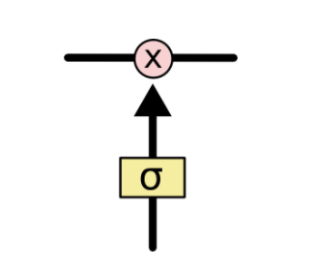
Modeling
SJIET
ELAVUR
Hidden layer of RNN with LSTM cell:
LSTM = Long short term memory

Slide 34
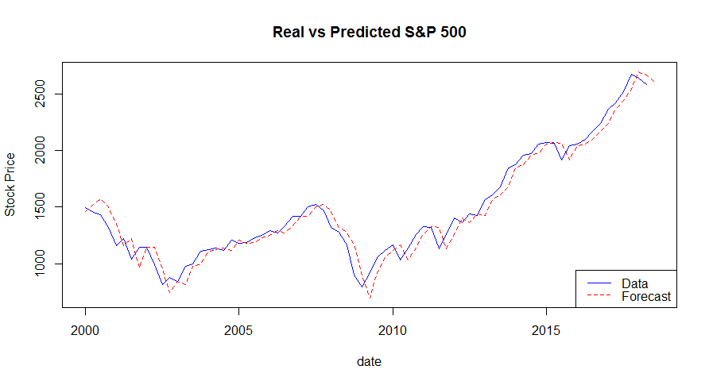
Prediction & Comparison
SJIET
ELAVUR
ARIMA

Slide 35
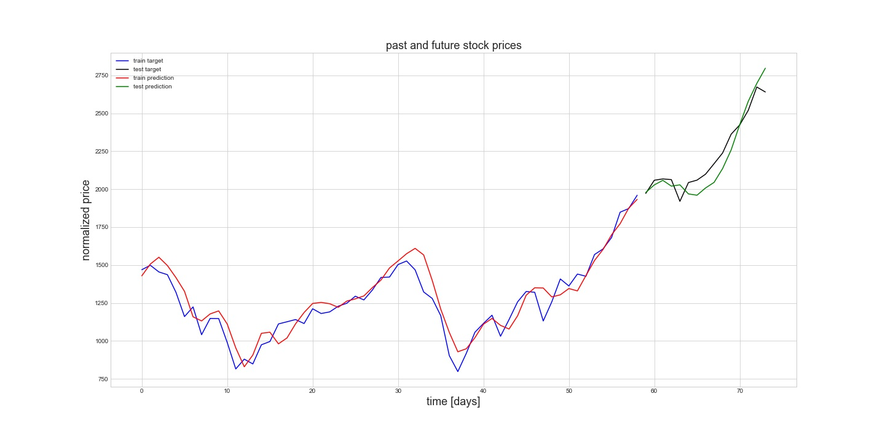
Prediction & Comparison
SJIET
ELAVUR
RNN

Slide 36
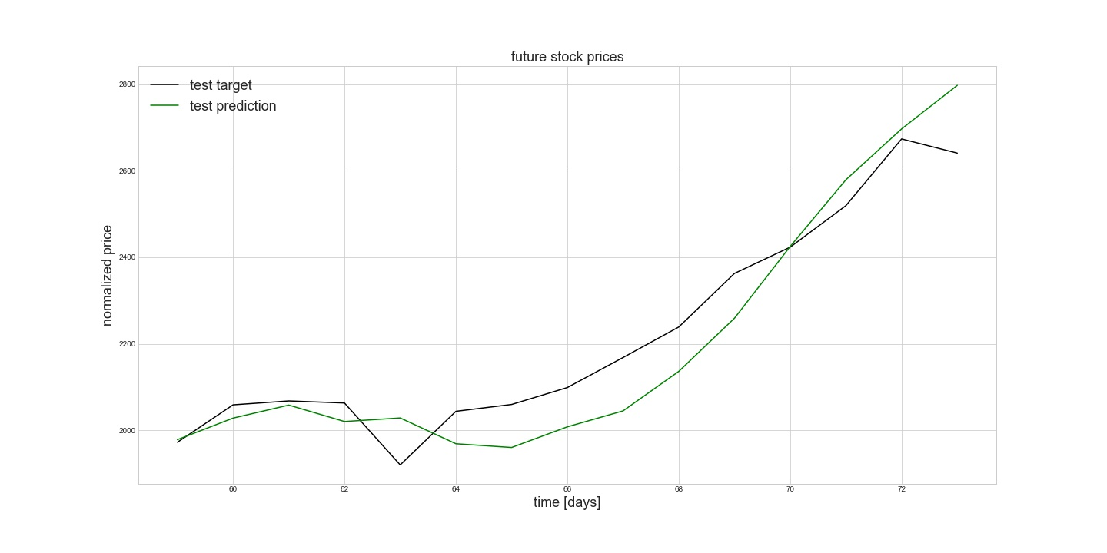
Prediction & Comparison
SJIET
ELAVUR
RNN

Slide 37
Prediction & Comparison
SJIET
ELAVUR
MSE
MSE (ARIMA): 10835.62
MSE (RNN): 6864.68

Slide 38

SJIET
ELAVUR

